Slide 1
Realtime Custom Object Detection & Recognition Implementation
Presenters:-
Arul Raj (1001704417)
Divya Saxena (1001773376)
CSE-6363-002-Machine Learning
1

Slide 2
The Life Cycle
Defining Project
Objectives
Deployment of
Model
Data
Preparation
Evaluation of
Model
Training
Model
Testing the
Model
CSE-6363-002-Machine Learning
1

Slide 3
Implementation Parts
We have developed 3 parts of the Realtime object detection and recognition, namely
Celebrity Face Recognition in images
Here the Input will be an image for a celebrity with which the network (CNN) is trained and output will be the image with bounding boxes and labels around the celebrity faces.
COCO real-time multiple object detection using YOLO
Here the Input will be a video of common objects (COCO) that the YOLO is trained with and output will be the video with bounding boxes and labels around the objects.
Realtime object detection of input from webcam/Video
Here the Input will be the one from webcam, or a video of an object captured using webcam by drawing bounding boxes, since the network YOLO has been trained with that in the process therefore, output will be the video with confidence labels.
CSE-6363-002-Machine Learning
1

Slide 4
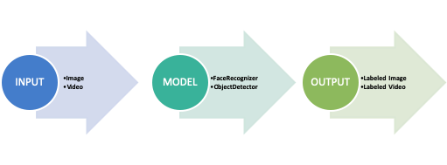
Process Flow
Supervised Training is executed, that is the training data is labeled using the YAT Annotation tool (as per the previous submission 2)
The input to the model will be an image or a video not from the training dataset.
The output will be the image or video having the bounding boxes with the labels around the corresponding object recognized as a part of this process.
CSE-6363-002-Machine Learning
1

Slide 5
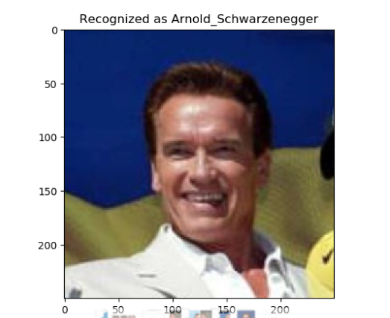
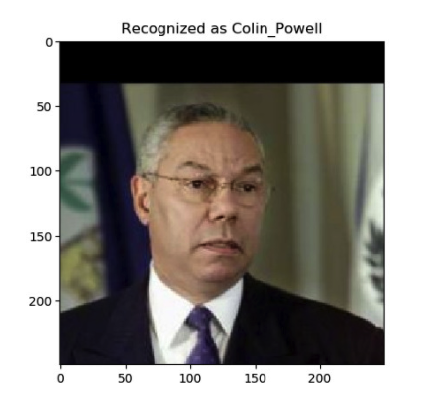
Celebrity Face Recognition
Implemented using Python libraries Keras, Dlib and OpenCV.
Face recognition using Keras is divided into 4 steps:
Detect/ Identify faces in an RGB image using Dlib and OpenCV – (face alignment)
Crop RGB image into 200X200 pixels
Design convolutional neural network using Keras
Train the model on the test model on testing data
CSE-6363-002-Machine Learning
1

Slide 6
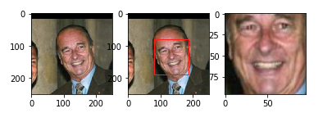
Celebrity Face Recognition- Face Alignment
The nn4.small2.v1 model was trained with aligned face images, therefore, the face images from the custom dataset must be aligned too.
Here, we have used Dlib for face detection and OpenCV for image transformation and cropping to produce aligned 96x96 RGB face images.
CSE-6363-002-Machine Learning
1

Slide 7
Celebrity Face Recognition- Embedding Vectors
These are 128-dimensional representations(vectors) or embeddings of faces from the aligned input images,
Calculated by feeding the aligned and scaled images from the face alignment step into the pre-trained network.
In embedding space, Euclidean distance directly corresponds to a measure of face similarity.
Compare input embedding vectors to labeled embedding vectors in a database.
CSE-6363-002-Machine Learning
1

Slide 8
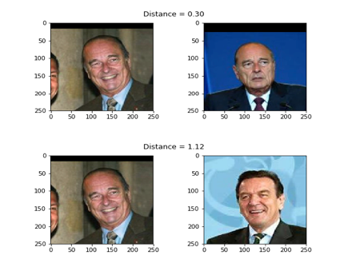
Celebrity Face Recognition- squared L2 distance
For verifying this on a single triplet example we have used the squared L2 distance between its anchor-positive pair is smaller than the distance between its anchor-negative pair.
But we still do not know what distance threshold τ is the best boundary for deciding between same identity and different identity.
CSE-6363-002-Machine Learning
1

Slide 9
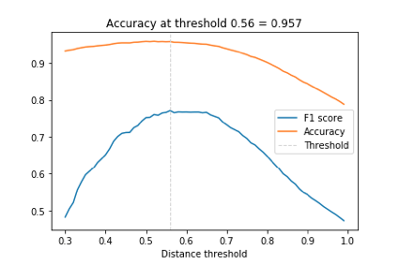
Celebrity Face Recognition- Accuracy
Since we have skewed data I.e. more negative pairs than positive pairs.
Therefore, we use F1 score as the evaluation metric rather than accuracy metric.
What should be the distance threshold?
performance needs to be evaluated on a range of distance threshold values.
CSE-6363-002-Machine Learning
1

Slide 10
Celebrity Face Recognition- Accuracy
Once we have estimated the distance threshold τ in the previous step,
Face recognition is as simple as calculating the distances between an input embedding vector and all embedding vectors in a database.
But we have used a more robust approach for labelling the input
Using KNN classification with a Euclidean distance metric
a linear support vector machine (SVM) trained with the database entries and used to classify i.e. identify new inputs.
The accuracy for celebrity recognition using 1. K-NN 2. Support Vector Machines (SVM) is 96% and 98% respectively.
CSE-6363-002-Machine Learning
1

Slide 11
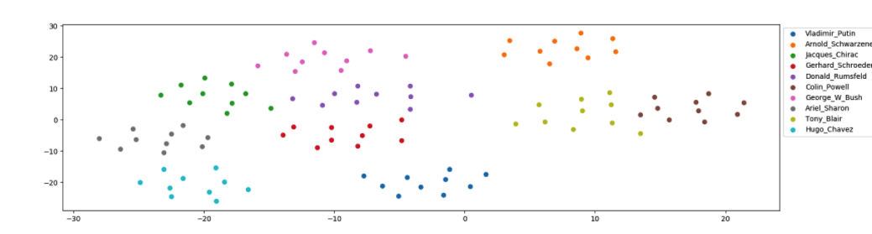
Celebrity Face Recognition- Dataset Visualization
To embed the dataset into 2D space for displaying identity clusters, t-distributed Stochastic Neighbor Embedding (t-SNE) is applied to the 128-dimensional embedding vectors.
Except from a few outliers, identity clusters are well separated.
CSE-6363-002-Machine Learning
1

Slide 12
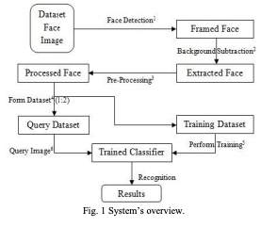
Celebrity Face Recognition- References
The reference we have followed for general ideas is about “Person Finder”
https://www.google.com/url?sa=t&rct=j&q=&esrc=s&source=web&cd=2&cad=rja&uact=8&ved=2ahUKEwjXi_L1jbvnAhVGIqwKHTJlDNQQFjABegQIAhAB&url=https%3A%2F%2Farxiv.org%2Fpdf%2F1302.6379&usg=AOvVaw3T9G28b-P1ECXauRR-dskp
What we have followed/used from this reference paper is the below flowchart.
And the Support Vector Machine classifier.
Extension:
Added the recognition feature for celebrities using neural networks with Keras.
CSE-6363-002-Machine Learning
1

Slide 13
COCO Realtime Multiple Object Detection
The COCO dataset is already pre-processed, therefore no need for pre-processing.
The dataset images or videos will be given as input to YOLO network that has been trained on COCO dataset.
The videos for input will be taken from the /videos folder in the project directory.
The output video with the bounding boxes with labels will be stored in the folder /output in the project directory.
CSE-6363-002-Machine Learning
1

Slide 14
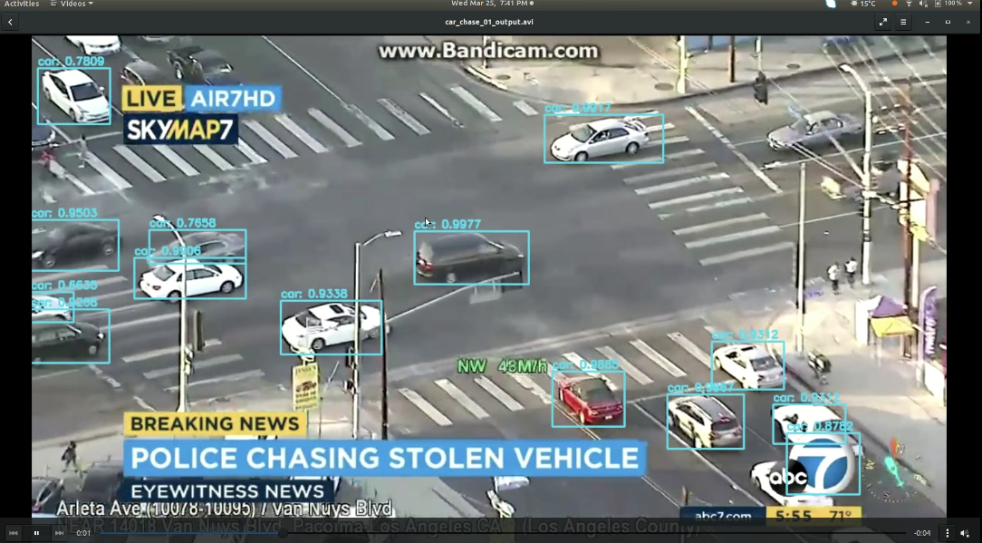
COCO Realtime Multiple Object Detection
CSE-6363-002-Machine Learning
1

Slide 15
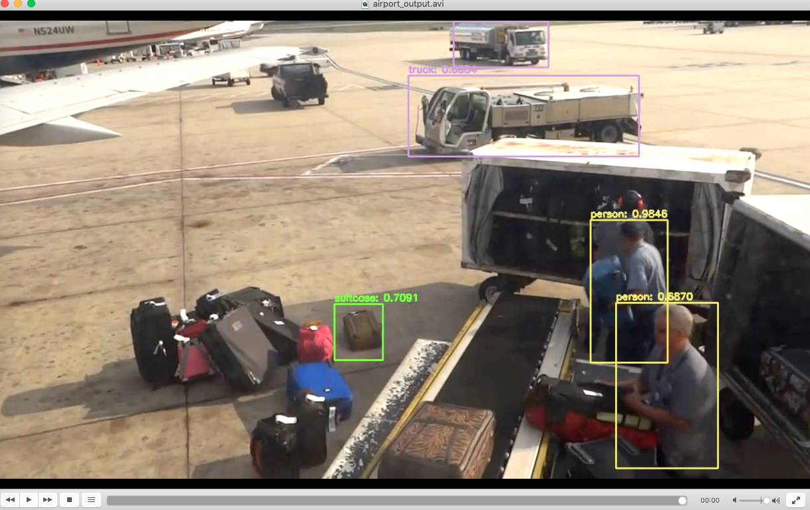
COCO Realtime Multiple Object Detection
CSE-6363-002-Machine Learning
1

Slide 16
Realtime Object Detection (Webcam)
The input will be captured by drawing the bounding boxes around the object to detect in real-time captured by the webcam.
The input will be the video or webcam (camera) whichever argument we supply at runtime.
The videos for input will be taken from the /videos folder in the project directory.
We can also change the trackers by supplying the relevant tracker IDs as outlined below,
csrt": cv2.TrackerCSRT_create
kcf": cv2.TrackerKCF_create
boosting": cv2.TrackerBoosting_create
mil": cv2.TrackerMIL_create,
tld": cv2.TrackerTLD_create
medianflow": cv2.TrackerMedianFlow_create
mosse": cv2.TrackerMOSSE_create
CSE-6363-002-Machine Learning
1

Slide 17
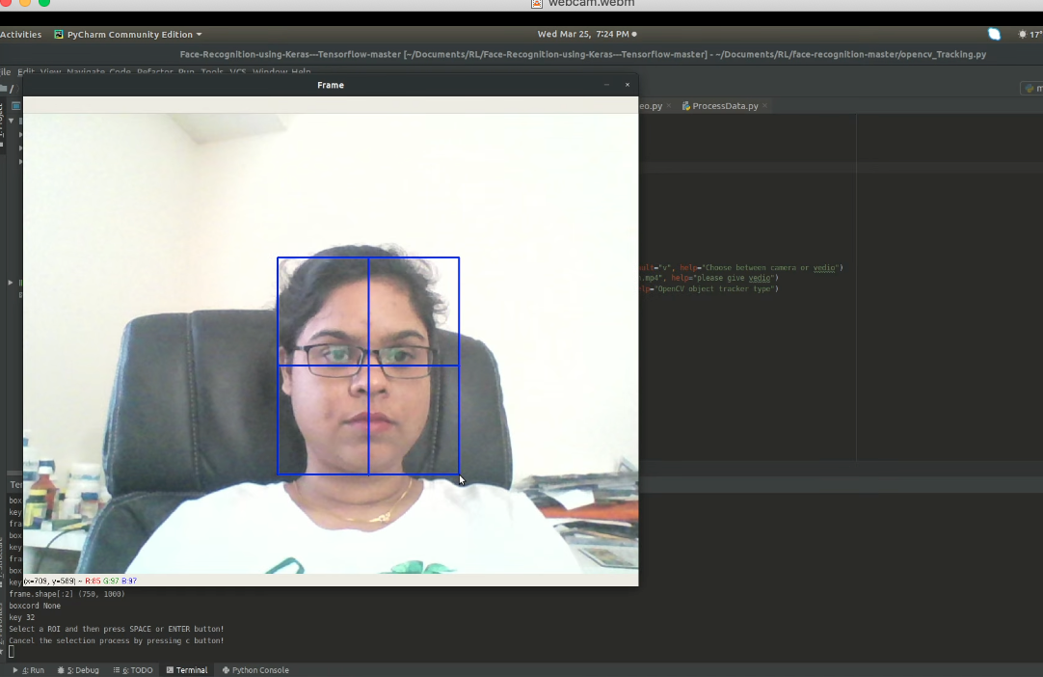
Realtime Object Detection (Webcam)
CSE-6363-002-Machine Learning
1

Slide 18
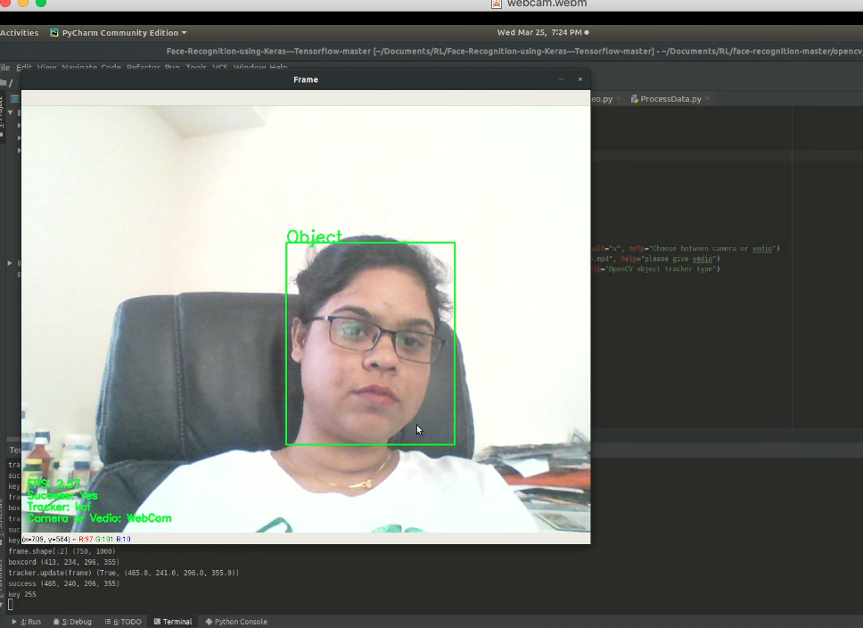
Realtime Object Detection (Webcam)
CSE-6363-002-Machine Learning
1

Slide 19
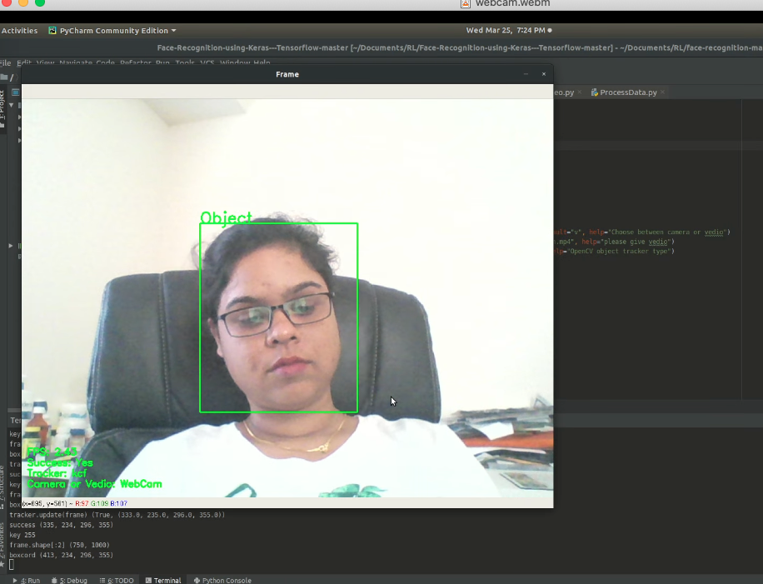
Realtime Object Detection (Webcam)
CSE-6363-002-Machine Learning
1

Slide 20
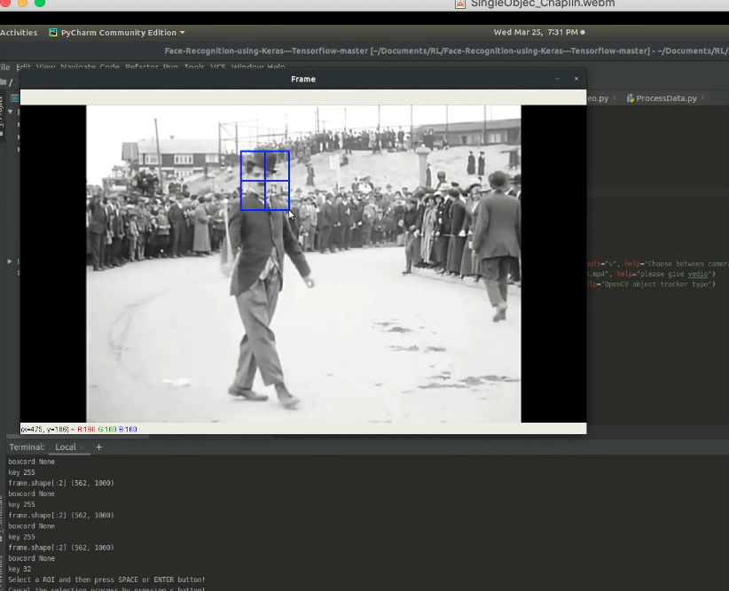
Realtime Object Detection (Webcam)
CSE-6363-002-Machine Learning
1

Slide 21
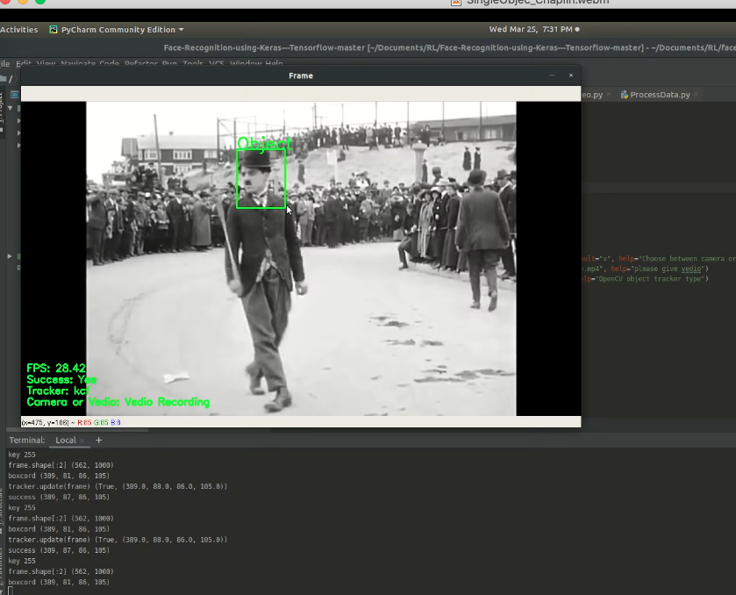
Realtime Object Detection (Webcam)
CSE-6363-002-Machine Learning
1

Slide 22


Timeline
February
March
April
May
Project scope evaluation.
Framing project description.
Timeline setup
Clubbing references.
Data Preparation
Starting up data cleaning and preprocessing
Implementation phase begins.
Working on a little over the project report.
Evaluation phase starts.
Integrating the code for submission.
Creating the project presentation.
Final submission of project report
CSE-6363-002-Machine Learning
1

Slide 23
Thank you !
CSE-6363-002-Machine Learning
<number>

